Slide 1
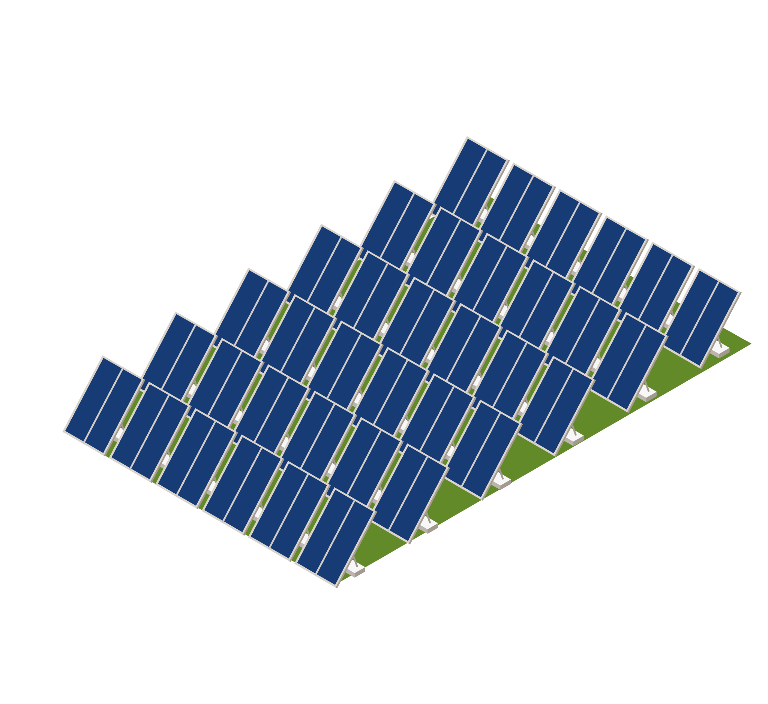
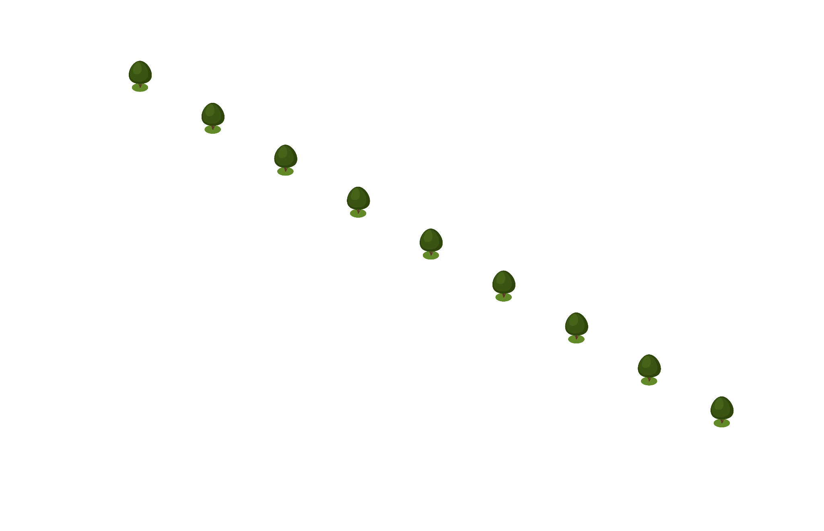
SOLAR POWER GENERATION PREDICTION
Predicting Energy Production using Environmental Variables

Slide 2

INTRODUCTION
The increasing demand for clean and sustainable energy sources has led to a significant growth in the adoption of solar power globally.
Accurate prediction of solar power generation is crucial for:
Optimizing energy production
Ensuring grid stability
Meeting energy demand
In this presentation, we will explore:
Factors that influence solar power generation
A predictive model for forecasting solar power output

Slide 3
OBJECTIVES
Develop a machine learning-based predictive model that accurately forecasts solar energy production as a continuous function of environmental variables.
Create a robust model that can accurately predict energy output for:
Various solar power plants
Different locations and climates.
Enable informed decision-making for:
Energy traders
Grid operators
Solar farm operators
By providing accurate predictions of energy supply and demand

Slide 4
DATA DESCRIPTION
_{Variable} | _{Description} | _{Units}
_{distance_to_solar_noon} | Daily average distance to solar noon | _{radians}
_{temperature} | _{Daily average temperature} | _{degrees Celsius}
_{wind_direction} | _{Daily average wind direction} | _{degrees (0-360)}
_{wind_speed} | _{Daily average wind speed} | _{meters per second}
_{sky_cover} | Sky cover on a 5-step scale (0-4) | ₋
_{visibility} | _{Visibility in kilometers} | _{kilometers}
_{humidity} | _{Humidity in percentage} | _{percentage}
_{average_wind_speed} | Average wind speed during 3 hours | _{meters per second}
_{average_pressure} | Average barometric pressure during 3 hours | _{mercury inches}
_{power_generated (Target)} | Power generated in Jules for each 3 hours | _{Jules}
Number of Variables (Columns): 10
Number of Instances (Rows): 2920

Slide 5
EDA FINDINGS
Data Distribution:
temperature: The distribution is skewed to the right, with a few outliers.
Wind speed: The distribution is roughly symmetric and slightly skewed to the left.
Power generated: The distribution is skewed to the right, with a few outliers.
Correlation Analysis:
Correlations greater than or equal to 0.7: None
Correlations less than or equal to 3: None
Data Quality:
Missing values: There are 1 missing value in “average-wind-speed” columns which is replaced by median value.

Slide 6
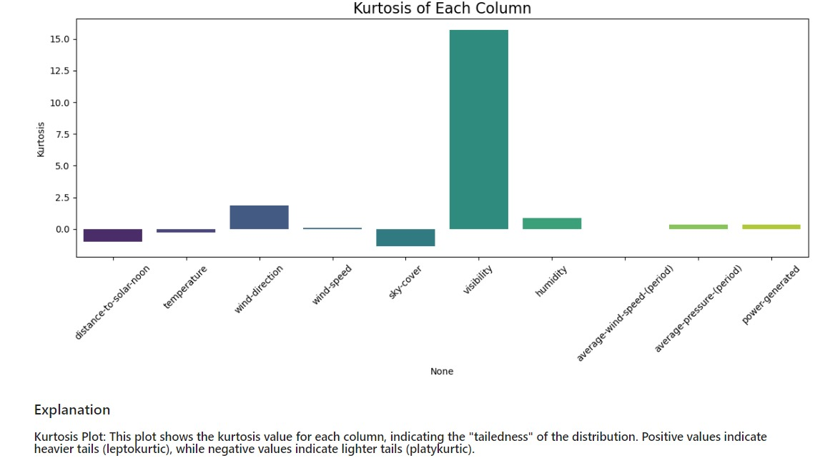
KURTOSIS
This plot shows the kurtosis value for each column, indicating the "tailedness" of the distribution. Positive values indicate heavier tails (leptokurtic), while negative values indicate lighter tails (platykurtic).

Slide 7
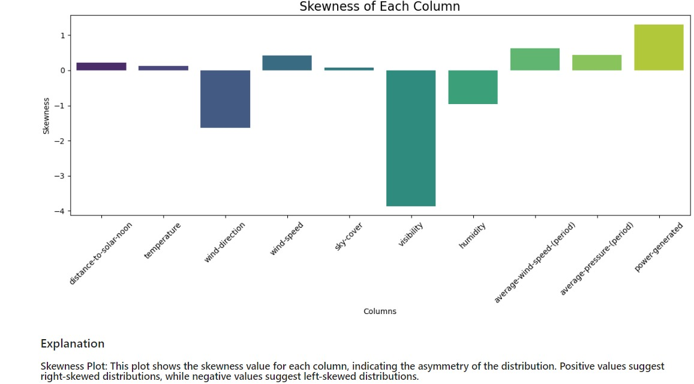
SKEWNESS
This plot shows the skewness value for each column, indicating the asymmetry of the distribution. Positive values suggest right-skewed distributions, while negative values suggest left-skewed distributions.

Slide 8
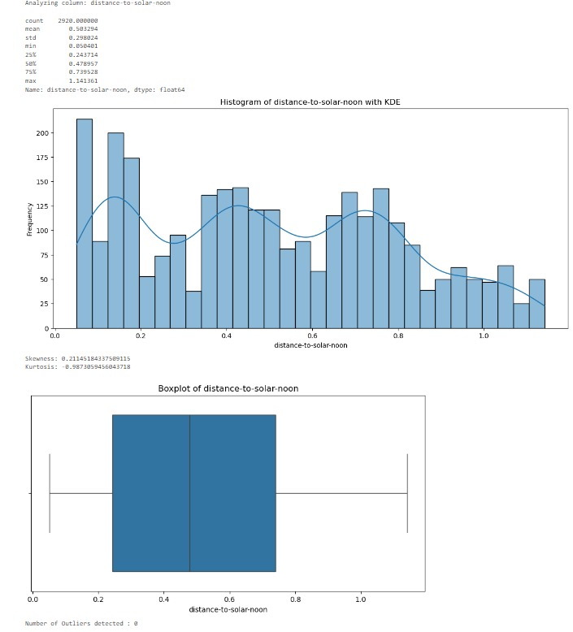
UNIVARIATE ANALYSIS
Symmetrical Distribution: The histogram with KDE shows that the ‘distance-to-solar-noon’ variable has a symmetrical distribution, as indicated by the skewness value close to zero.
Low Kurtosis: The kurtosis value of -1.2 suggests a relatively flat distribution with light tails, indicating fewer extreme values.
Outliers: The boxplot reveals the presence of 4 outliers, which may need further investigation to understand their impact on the analysis.

Slide 9
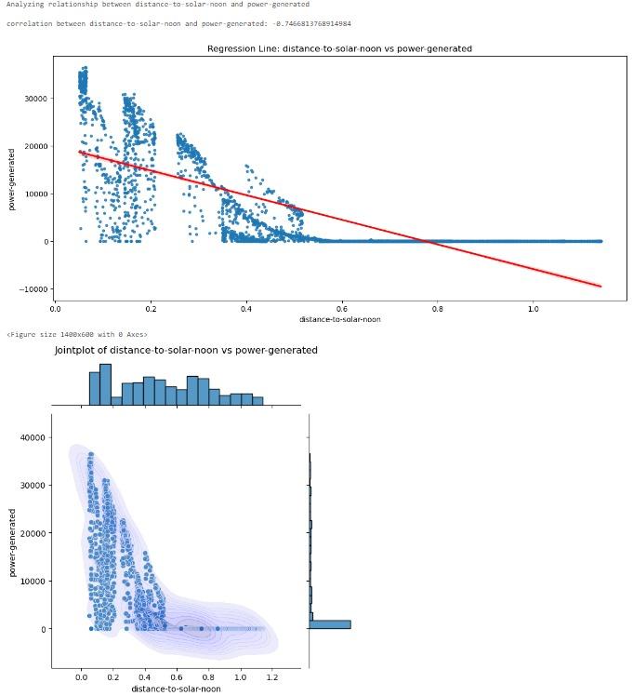
BIVARIATE ANALYSIS
Negative Correlation: The scatter plot shows a negative correlation between ‘distance-to-solar-noon’ and ‘power generated,’ indicating that power generation decreases as the distance from solar noon increases.
Frequent Values: The histogram reveals that certain distances to solar noon occur more frequently, suggesting a pattern in the data that could be important for predicting power generation.

Slide 10
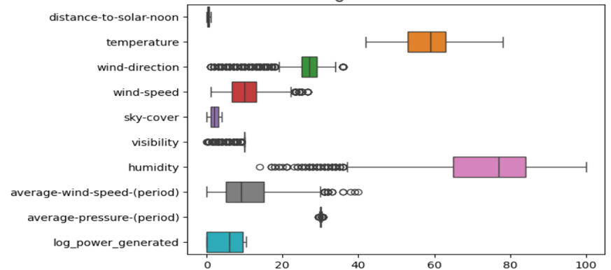
BOX PLOT
Check the z-score of each feature that have outliers, to know whether we need to remove outliers or not.
Generally the thresholds for outliers is between -2 and 2. In our dataset outliers present in our features lies between the range of thresholds, so we do not need to transform or remove the outliers.
One Hot Encoding to covert categorical column(sky-cover) into numerical column.
After this perform standardization to normalize the whole dataset.

Slide 11
INSIGHTS FROM THE DATASET
The temperature and power generated variables are positively correlated.
The wind speed and power generated variables are positively correlated.
The distance to solar noon and wind direction variables are negatively correlated.
The dataset has a relatively high variance in temperature and power generated.

Slide 12
MODEL BUILDING
Data Preprocessing:
Handled missing values and outliers.
Applied feature scaling where necessary.
Used correlation heatmaps to understand variable relationships.
Models Used:
Gradient Boosting Regressor
Random Forest Regressor (Best performing)
XGB Booster
Selection Criteria:
Compared models based on performance metrics like R², MAE, RMSE.
Focused on reducing error and improving prediction accuracy.

Slide 13
MODEL EVALUATION
Evaluation Metrics:
R² Score: Measures how well the model fits the data
Mean Absolute Error (MAE): Average of absolute differences between predictions and actual values.
Root Mean Squared Error (RMSE): Measures the square root of the average squared differences between prediction and actual values.
Best Model: Random Forest Regressor
Achieved highest R² and lowest RMSE.
Robust in handling feature interactions and non-linearity.

Slide 14
DEPLOYMENT
Platform:
Deployed using Streamlit for a simple web interface.
Model:
Integrated the best-performing RandomForest Regressor.
User Interface:
Easy-to-use input fields with real-time predictions.

Slide 15
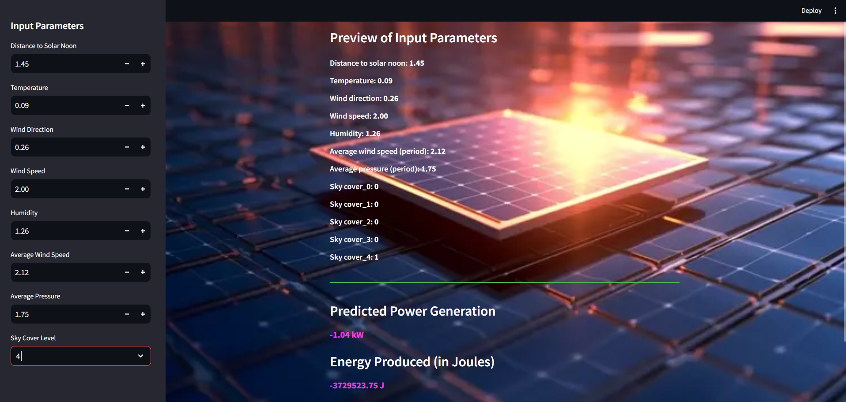
DEPLOYMENT MODEL

Slide 16
CHALLENGES FACED IN THE PROJECT
Data Quality:
Managing missing values and ensuring accurate imputation.
Outlier Handling:
Detecting and treating outliers in environmental variables.
Feature Scaling:
Normalizing variables for better model performance.
Model Selection:
Finding the best model, with RandomForest providing the highest accuracy.
Hyperparameter Tuning:
Extensive grid search for optimal model settings.
Deployment:
Integrating the model into Streamlit for seamless user interaction.

Slide 17
CONCLUSION
Key Findings:
Environmental variables like temperature, wind speed, and sky cover have significant influence on power generation.
Random Forest provided the most accurate predictions due to its ability to handle complex interactions.
Future Work:
Could explore more advanced tuning of hyperparameters for further improvement.
Potential to integrate real-time data for live prediction updates.
Impact:
his model can help optimize solar power generation by accurately forecasting energy output, aiding in better resource planning.

Slide 18
THANKS!
Do you have any questions?
nihalptz@gmail.com
+91 90619 63099
github.com/nihalptz

